Slide 1
Creative Health in Context How Doncaster is leading a national social movement to embed creativity and promote healthy communities
Presentation to Cast Communities Event
Prof. Chris Dayson, Sheffield Hallam University, 5th March 2025

Slide 2
What is Creative Health?

Slide 3
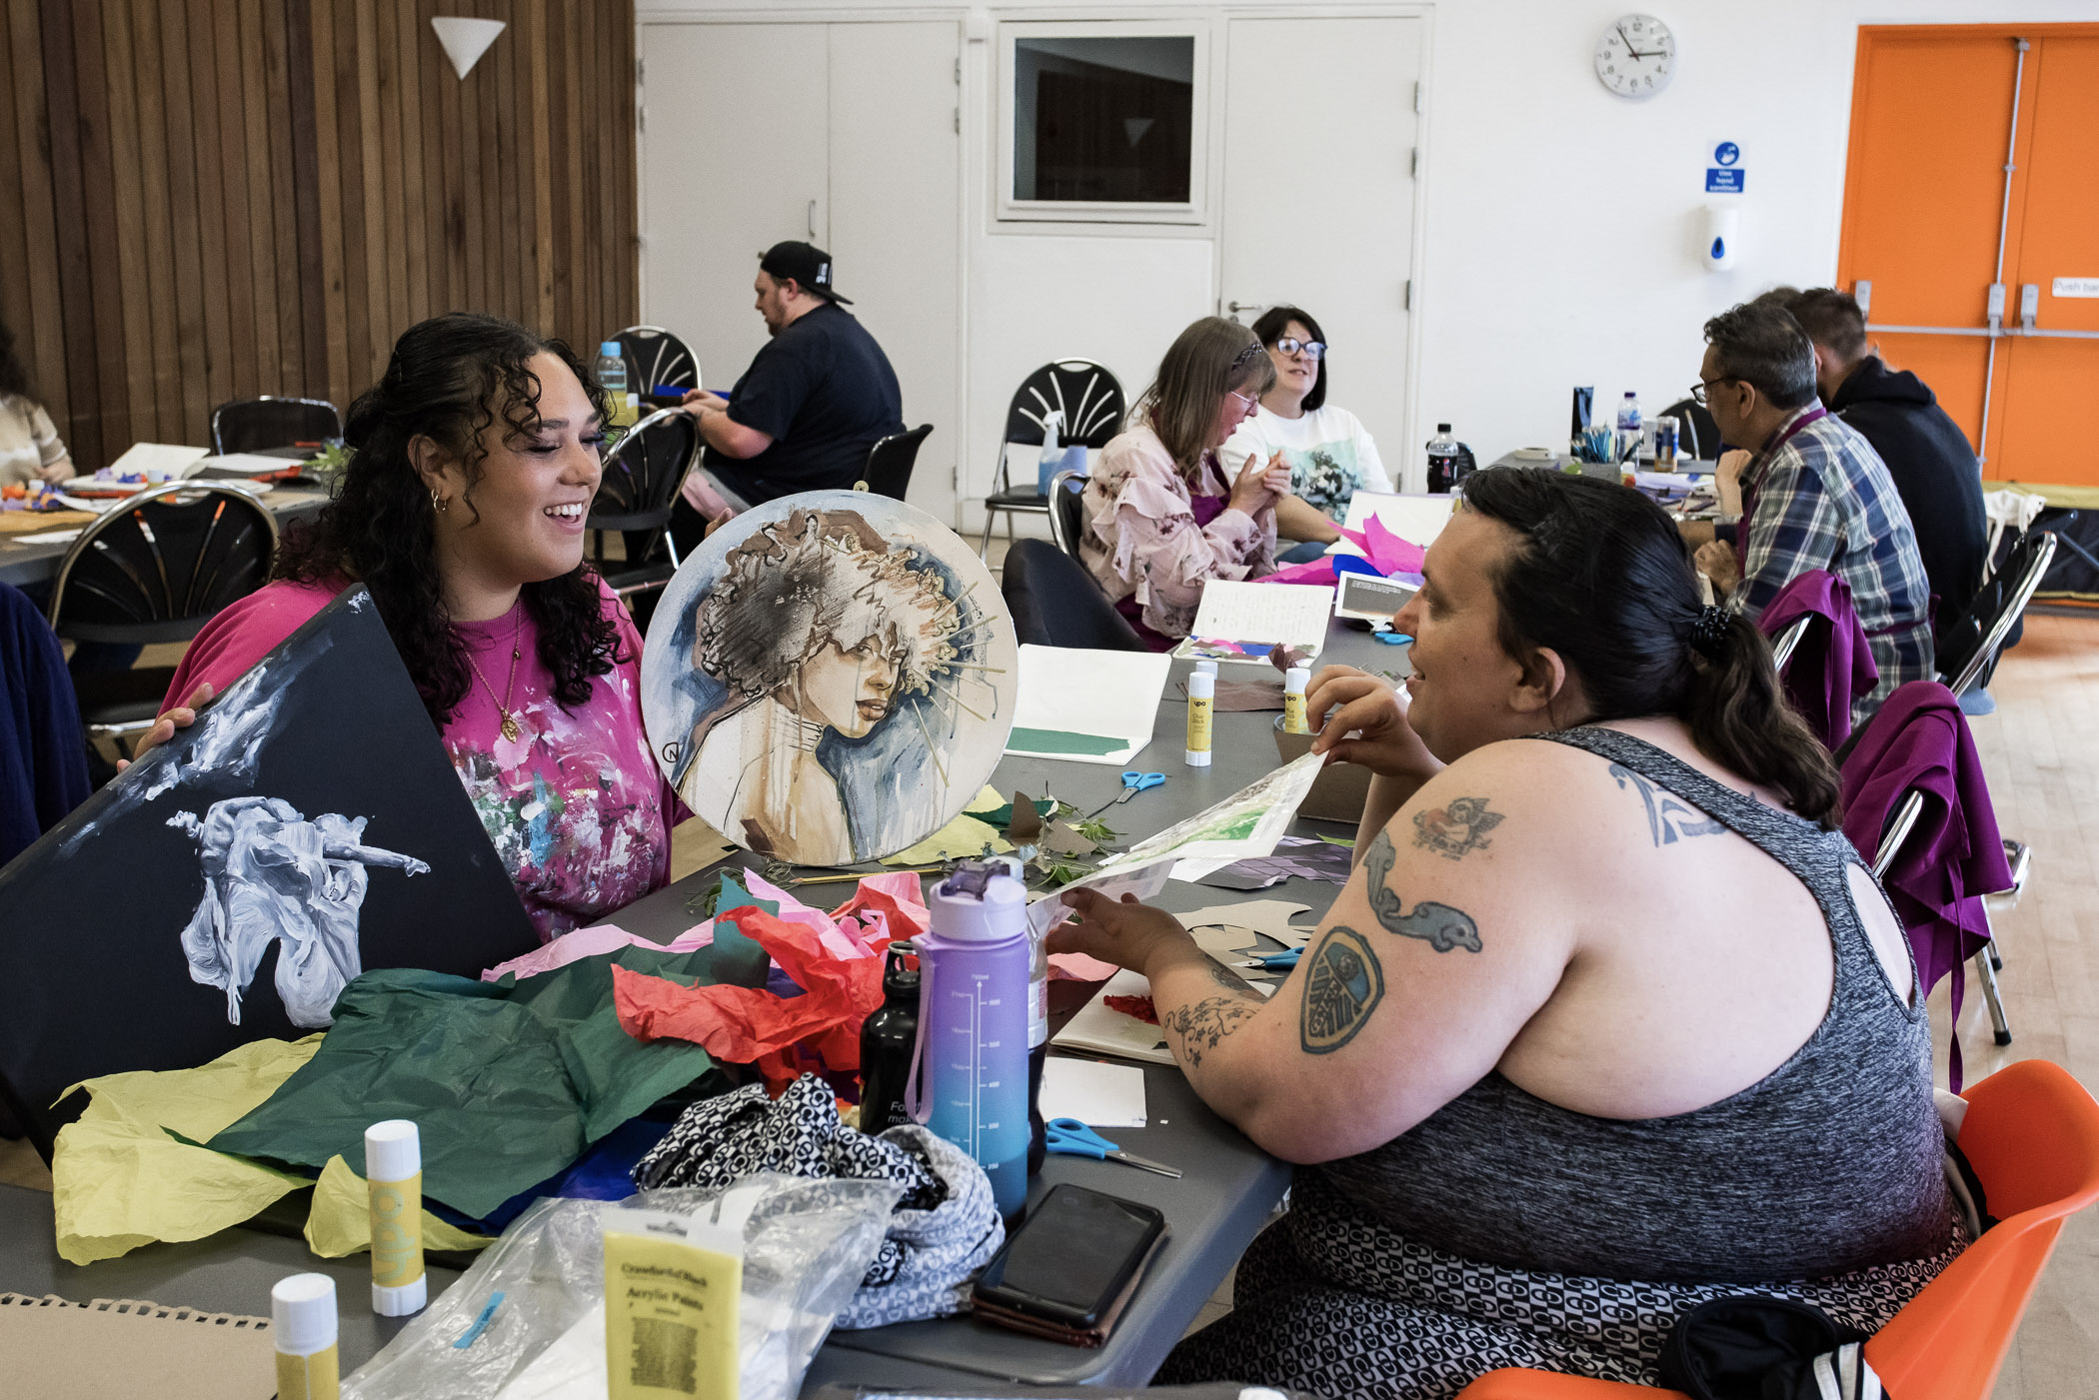
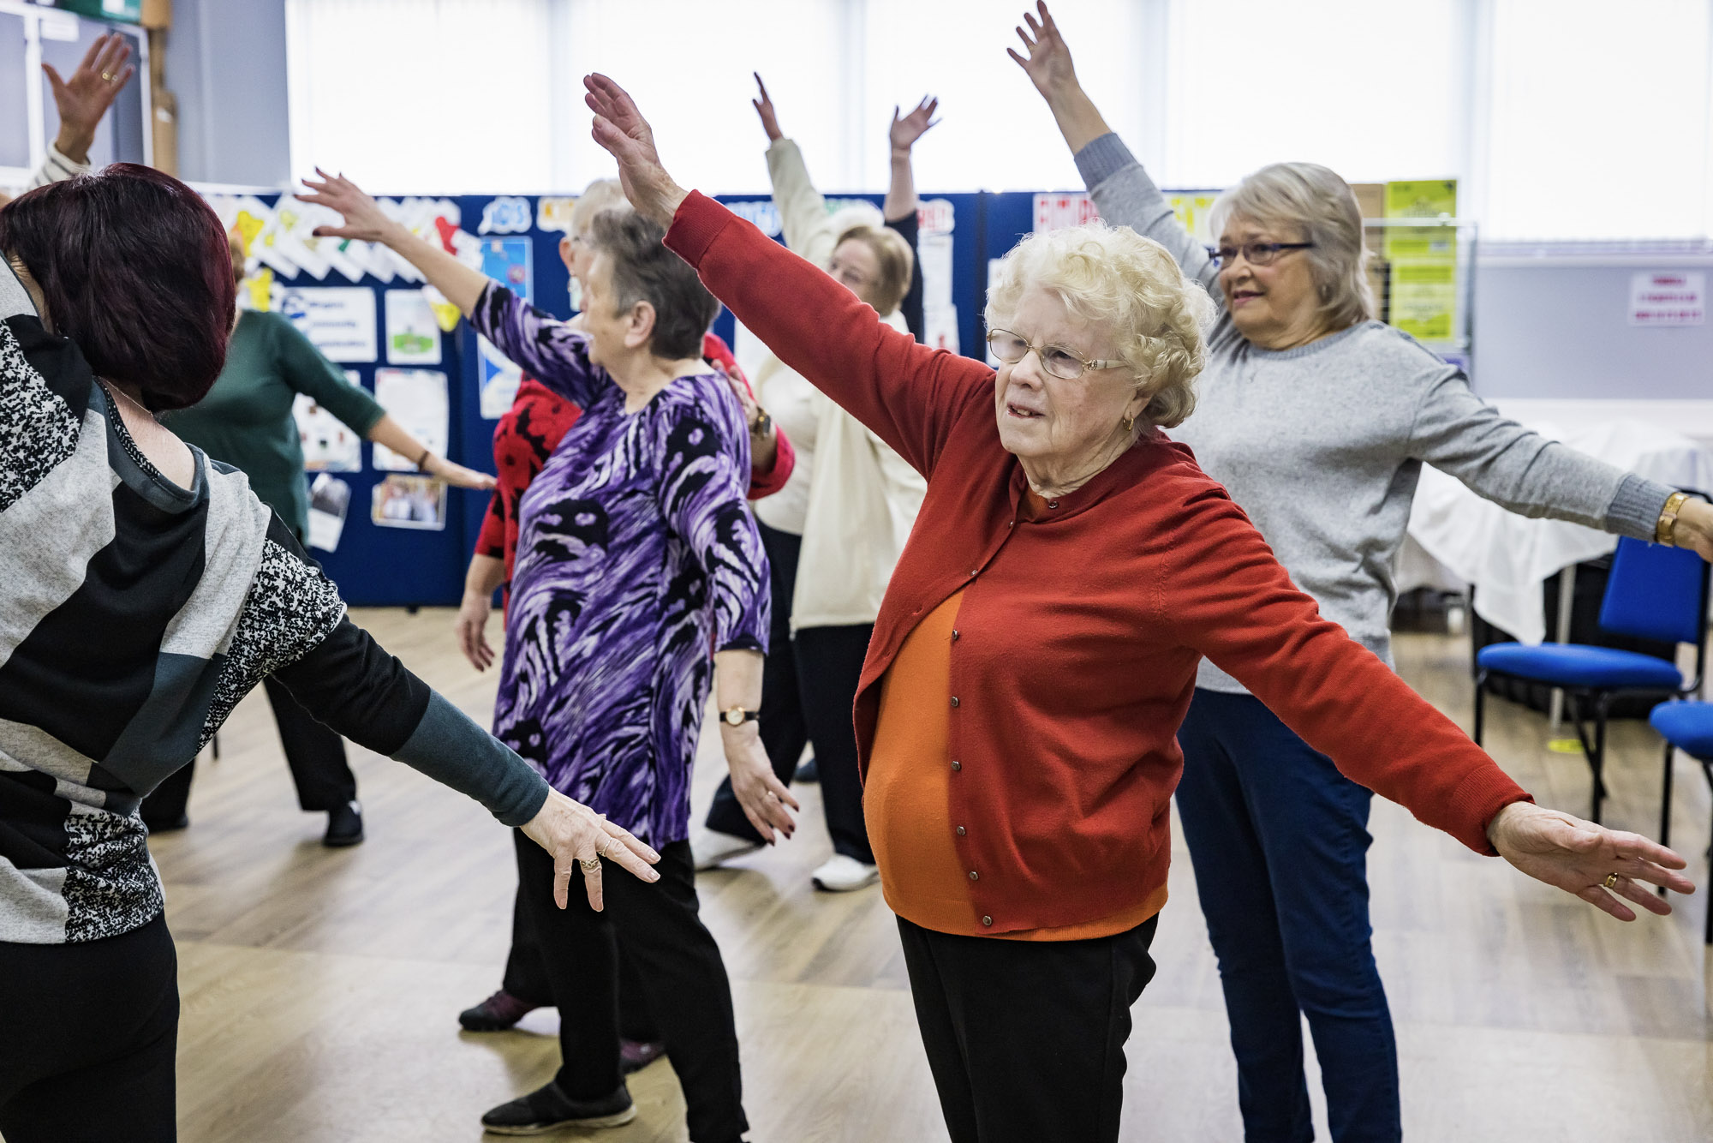
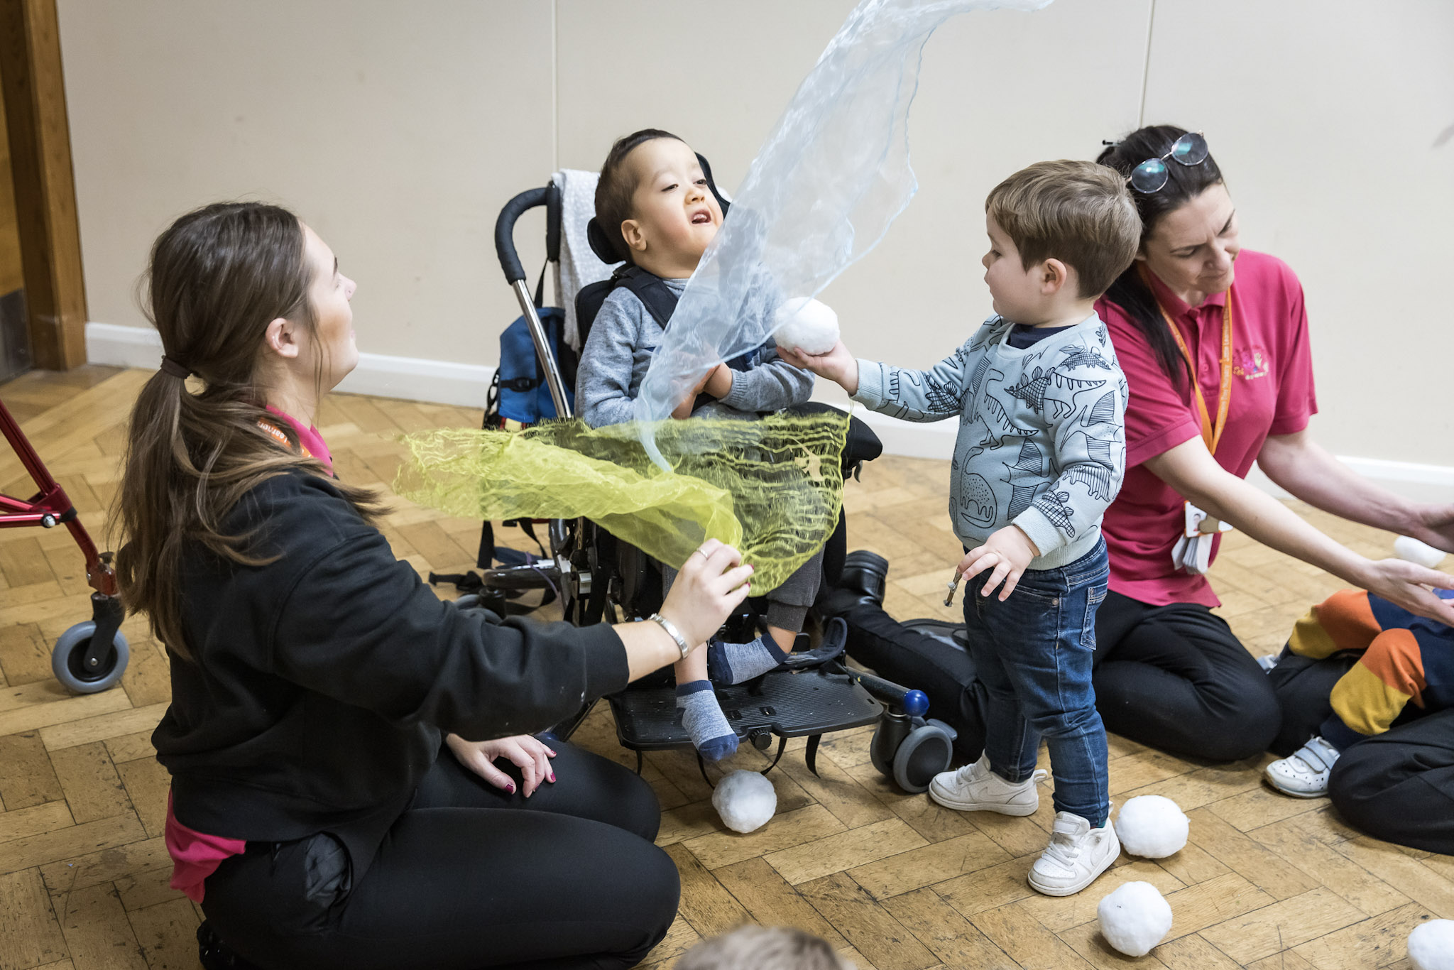
A simple high-level definition
Creative Health is...
...creating the conditions and opportunities for arts, creativity and
culture to be embedded in our health services

Slide 4
What is the evidence for creative health?
Good news! Lots of robust academic evidence that creativity is good for health:
A WHO report in 2019 analysed over 900 studies and concluded that arts engagement can prevent illness, promote well-being, and support management and treatment of health conditions.
Mental health effects include lowering cortisol (a cause of stress) and increased dopamine (linked to pleasure and motivation).
Neurological and cognitive effects for conditions such as dementia and Parkinson’s Disease.
Wellbeing and community effects linked to increased social connectedness, reduced loneliness, and improved social inclusion.
Health systems effects include reduced healthcare costs from fewer GP visits and hospital admissions.

Slide 5
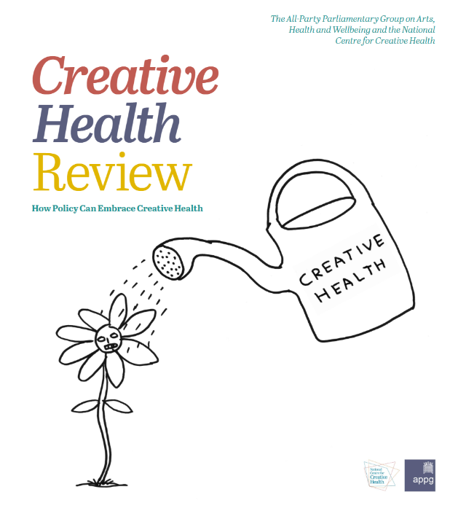
A win-win-win for individuals, communities and health systems?
Growing policy and political support but concerns about...
Is creative health reaching everyone who needs it?
Underinvestment in creative community assets.
Sustainability and the longevity of creative activities.
Join-up and influence within health systems.
That’s where our project comes in!

Slide 6
The Creative Health Boards (CHB) Project

Slide 7
The CHB: a new model for embedding creative health and community assets in health systems across the UK
Project aims: Develop, and support the scale and spread of, a replicable governance model that will support the embedding of art, culture and other creative activities within health and care systems.
Guiding principle: CHBs should equitably involve, and ideally be led by, creative and cultural community assets, but with clear accountability to/from Integrated Care Systems and other appropriate governance fora.
Funding provides investment in partner capacity to support the research

Slide 8
Our starting point
Doncaster – the home of the first CHB - as an evidence hub and innovation test bed...

Slide 9
Our starting point
But also drawing on learning and best practice from other areas...

Slide 10
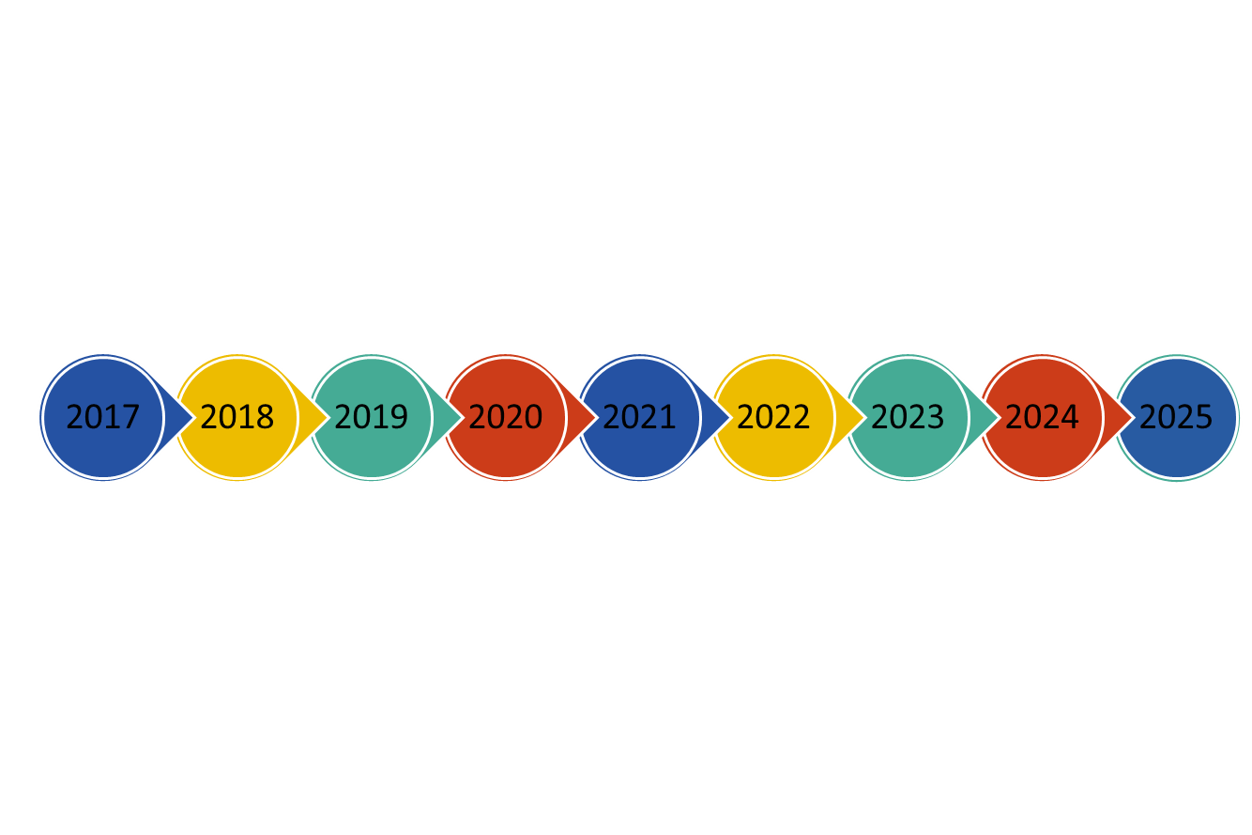
Doncaster CHB Timeline
Doncaster AHB paused due to Covid 19
Doncaster AHB Founded
Doncaster AHB resumes
CHB project commences
Publication of CH Review
CH presentation to SY ICB
Launch of SYCHB

Slide 11
How does the CHB fit with the health system and communities?
Community Asset CHB Members
Creative Health Ecosystem
Doncaster HWB Board
Doncaster CHB
Creative Health Connector
Lived Experience
S Yorks ICP
S Yorks CHB
Health System CHB Members
Wider Health System/Public Sector

Slide 12
What is the focus of our research?

Slide 13
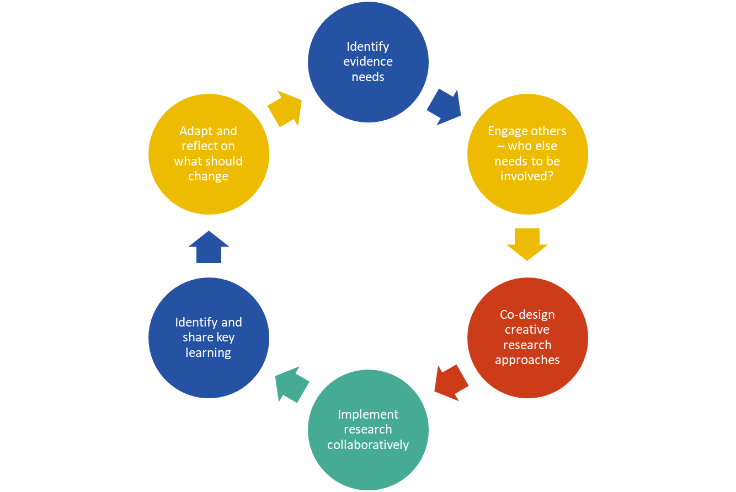
Co-production through participatory action research (PAR)

Slide 14
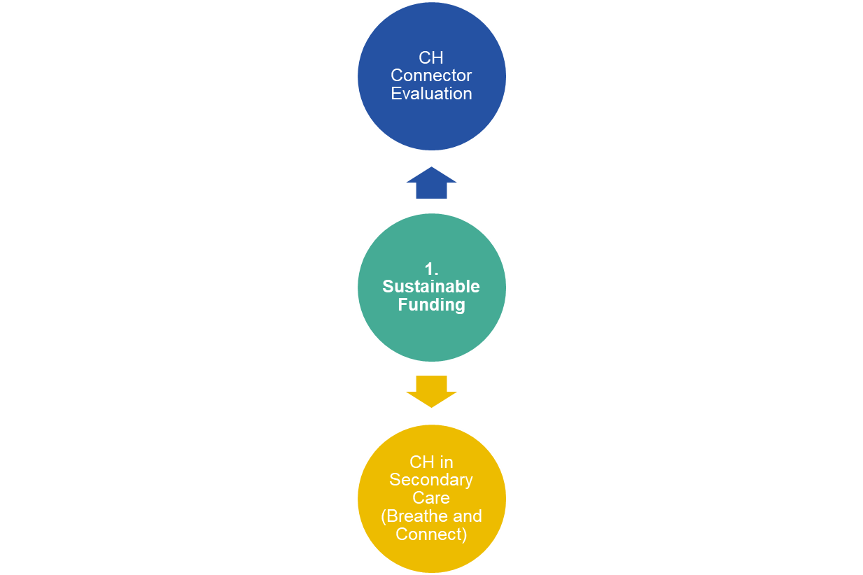
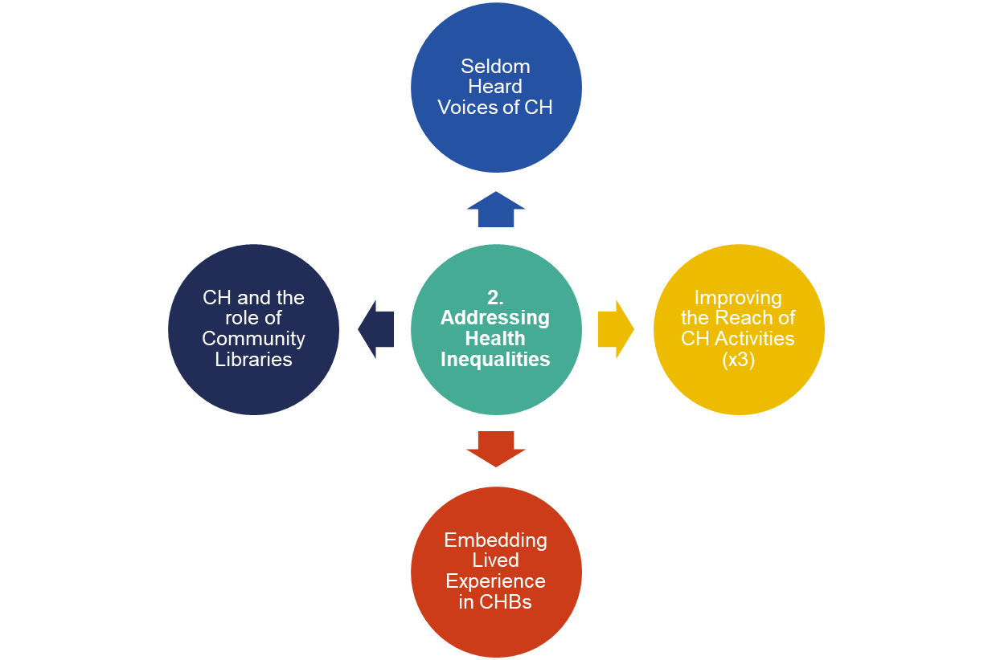
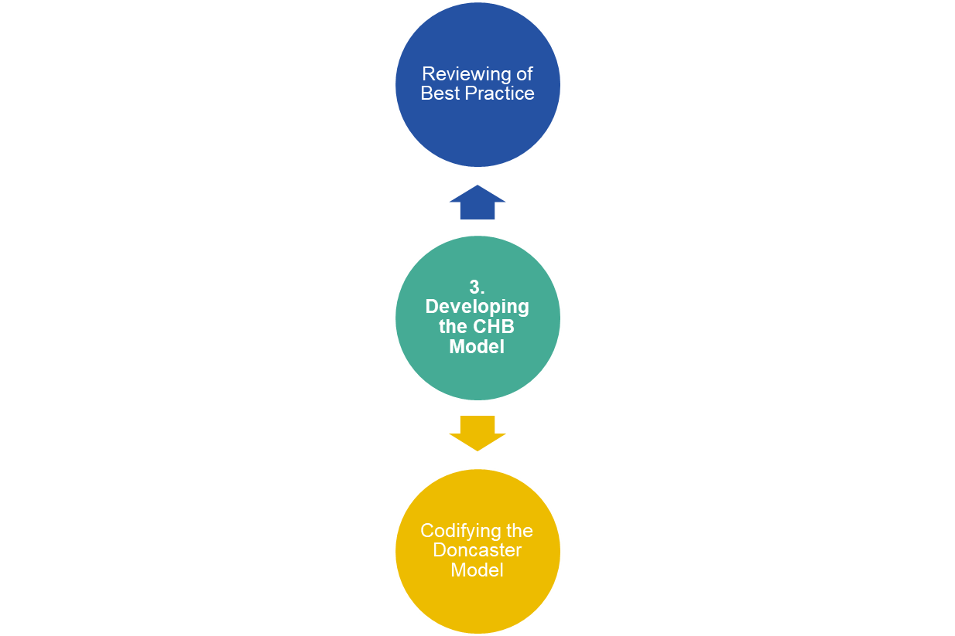
Supporting CHB development through PAR

Slide 15
How can you engage with our project?

Slide 16
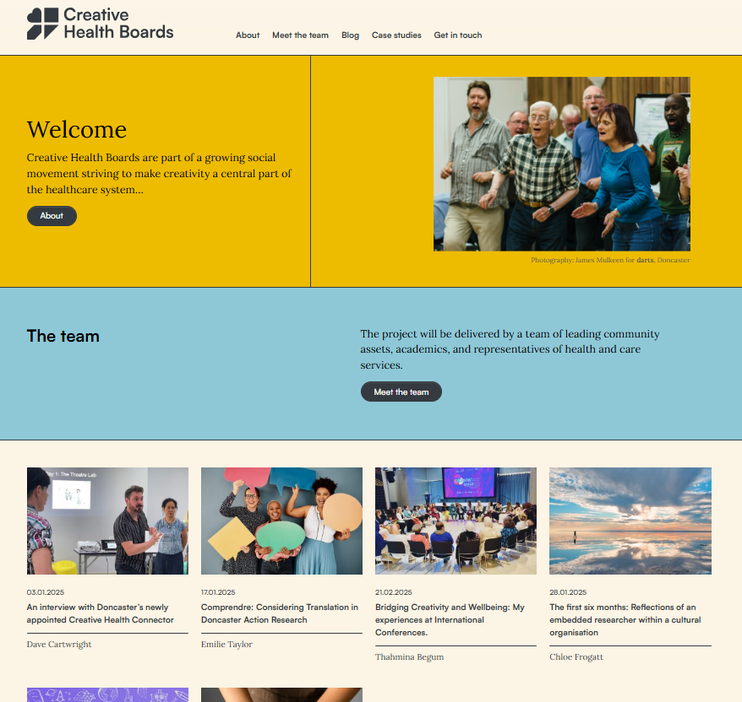
Visit the project website
Access our evidence and learning via the CHB hub... creativehealthboards.org.uk
Blogs
Case studies
Research reports and outputs

Slide 17
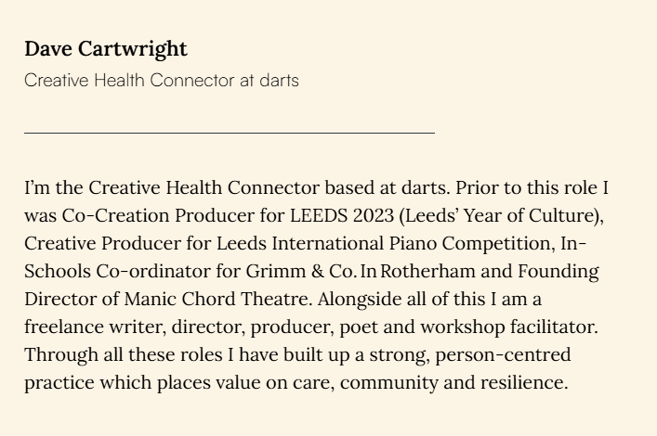
Contact our Creative Health Connector
Dave is based at darts but works across Doncaster to connect people and communities around creative health

Slide 18
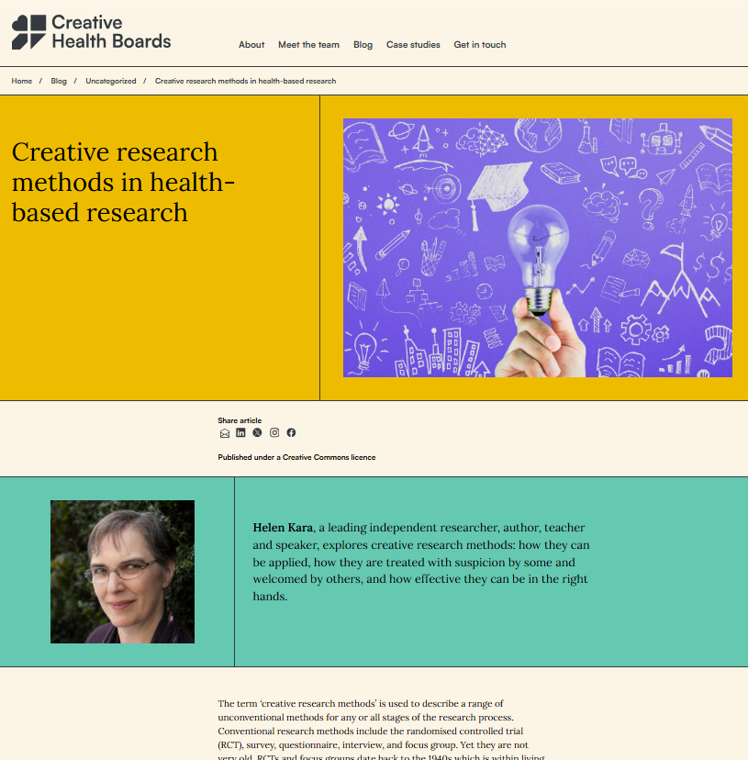
Take part in one of our capacity building sessions
We are running a programme of activities to build research capacity within creative community assets

Slide 19
Thank you for listening!

