Slide 1
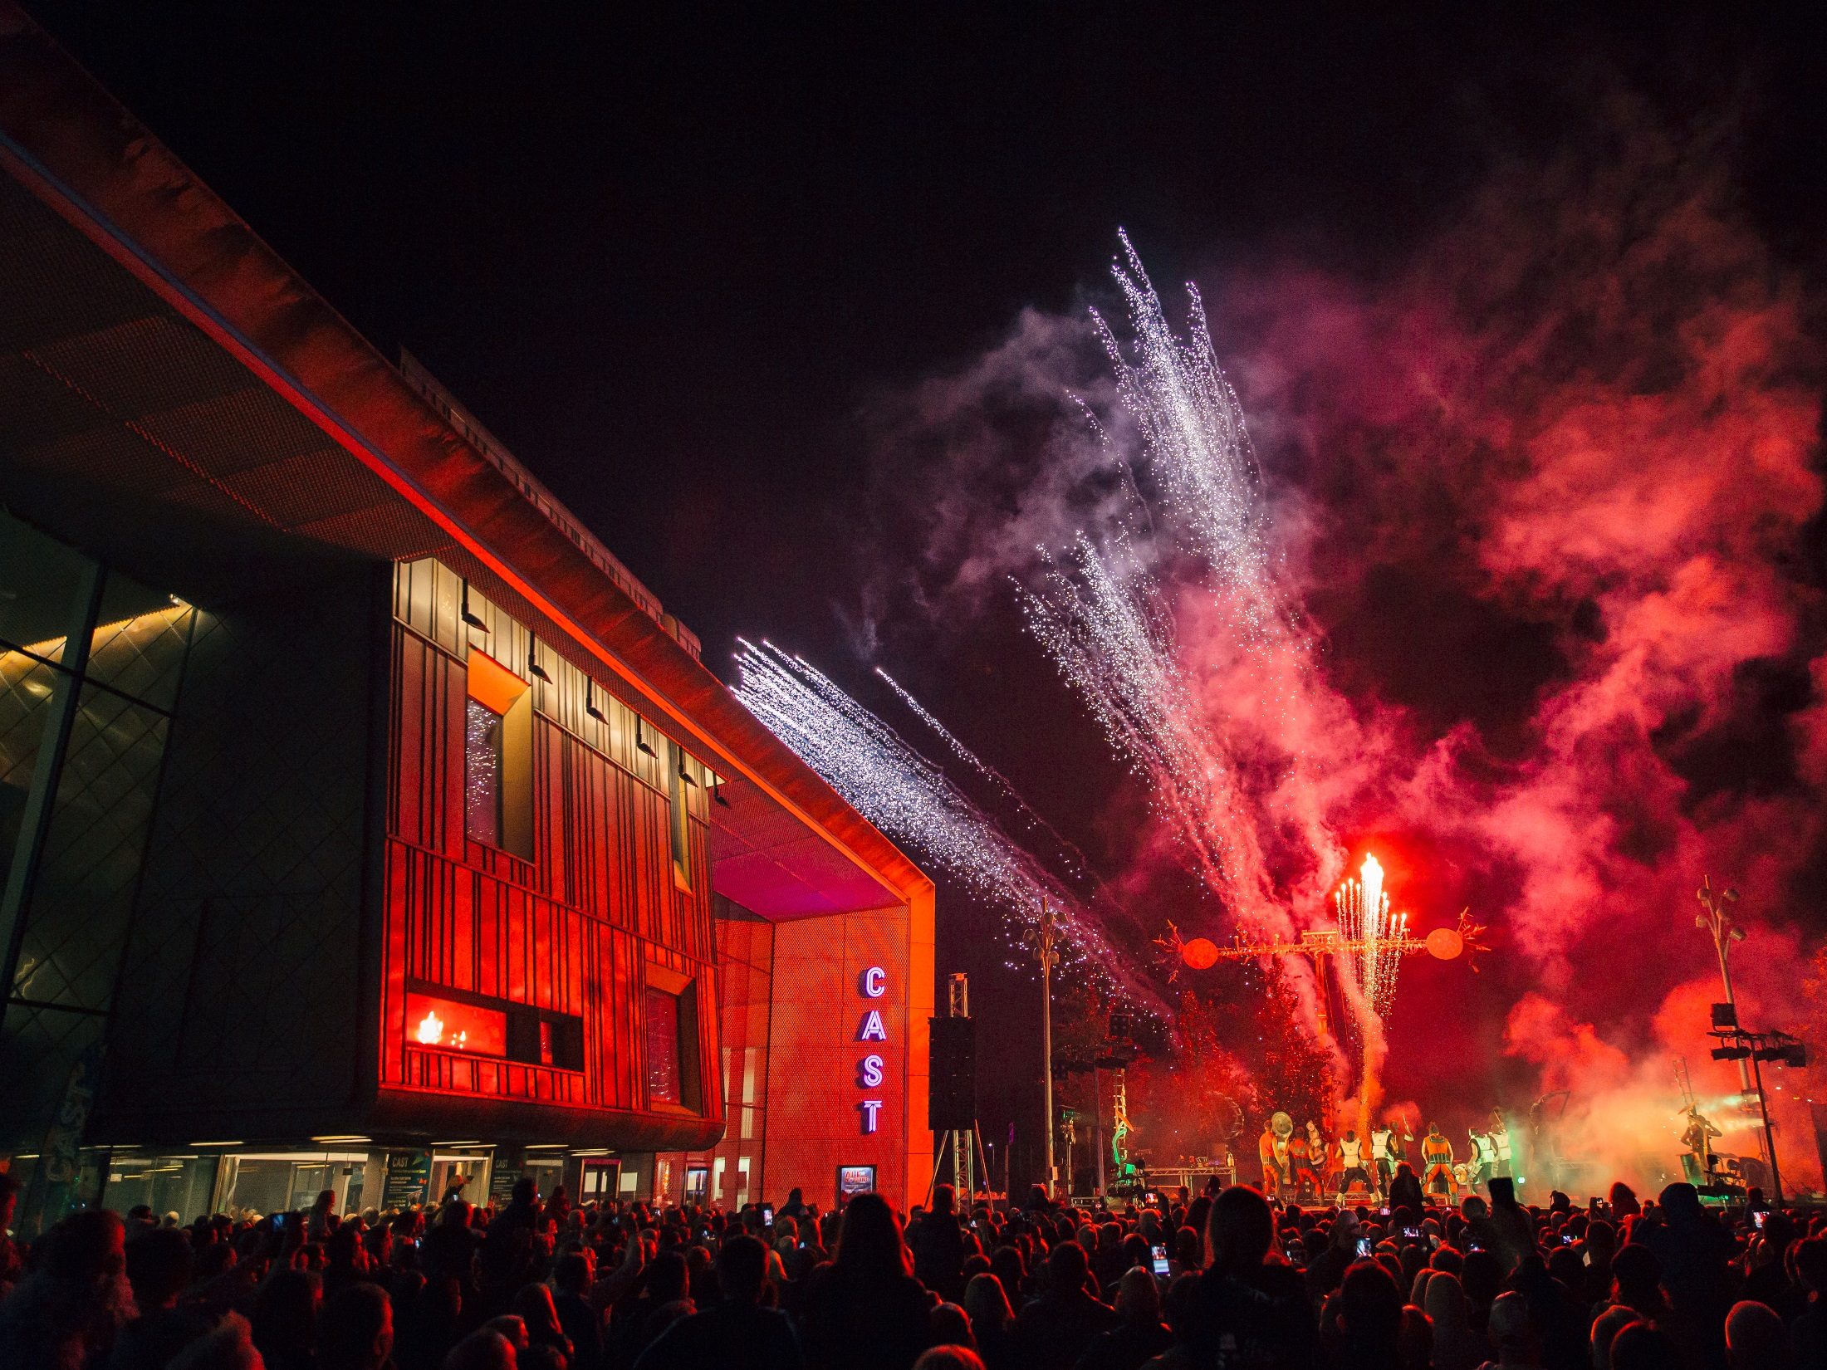
More info…………………
Corporate Partnerships
Evolution of Intergenerational Work
Registered charity no 1148432
Clash of Drums 2016

Slide 2
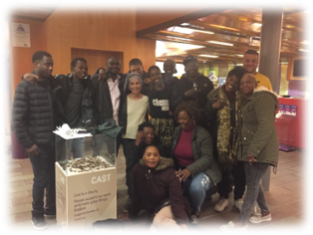
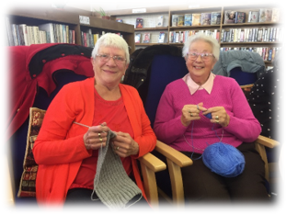
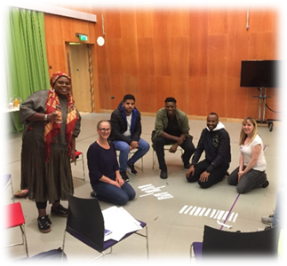
Working in Communities
Right Up Our Street Performances Social Seats
Last Seam
Cast Communities
Public Acts

Slide 3
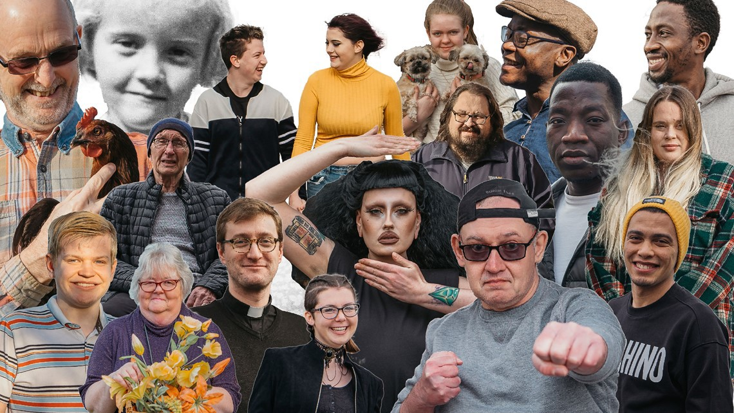
Stories to Get us Through (2020)
More info…………………

Slide 4
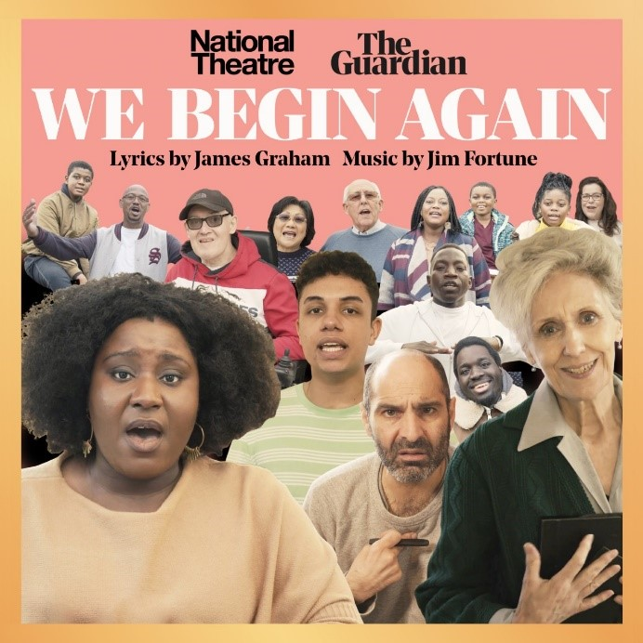
We Begin Again (2020)

Slide 5
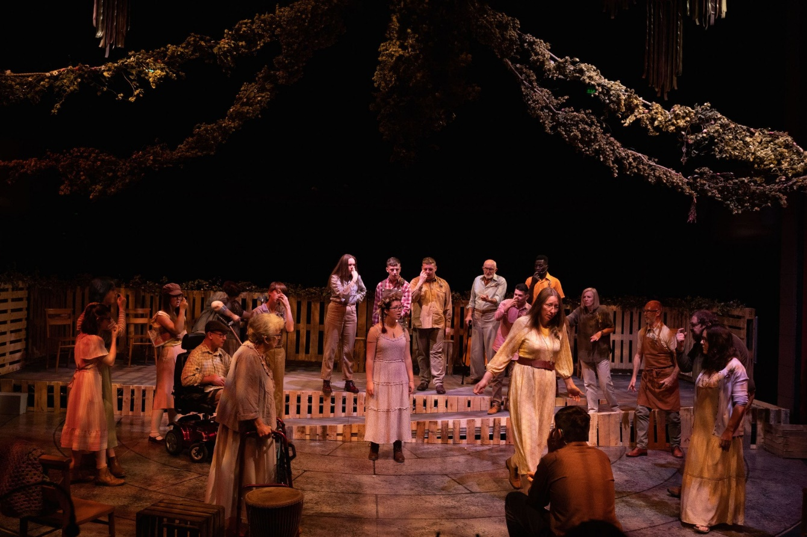
The Magic of Wild Heather (2021)

Slide 6
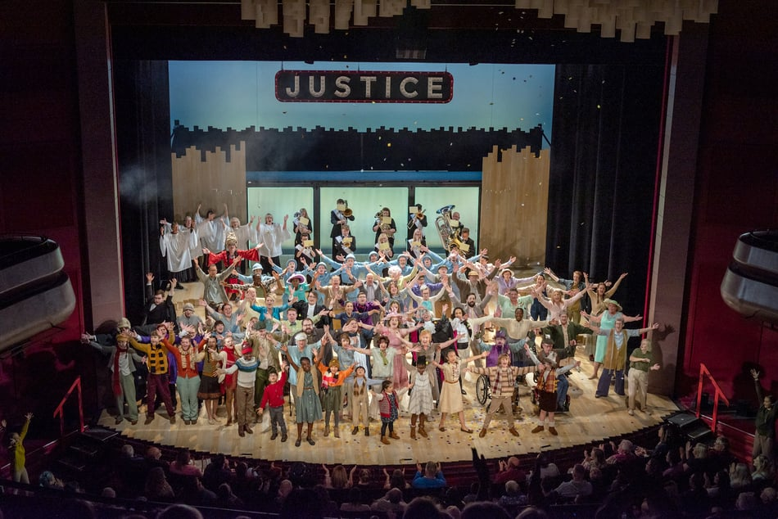
The Doncastrian Chalk Circle (2022)

Slide 7
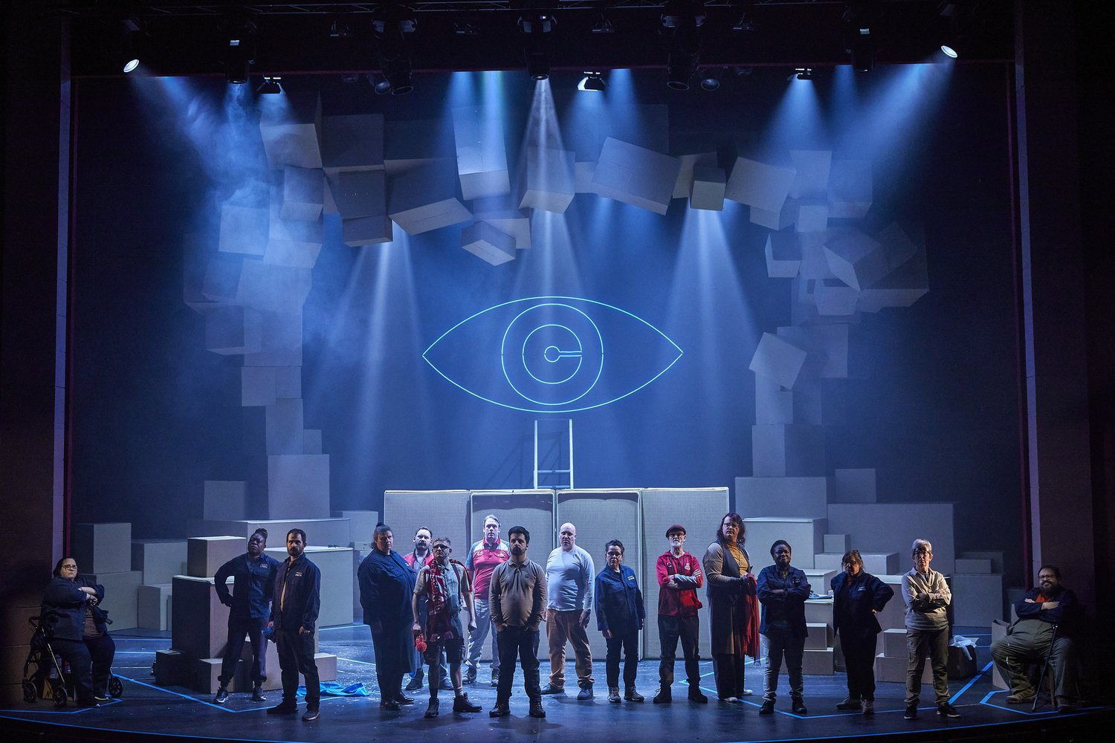
The Cyclops (2023)

Slide 8
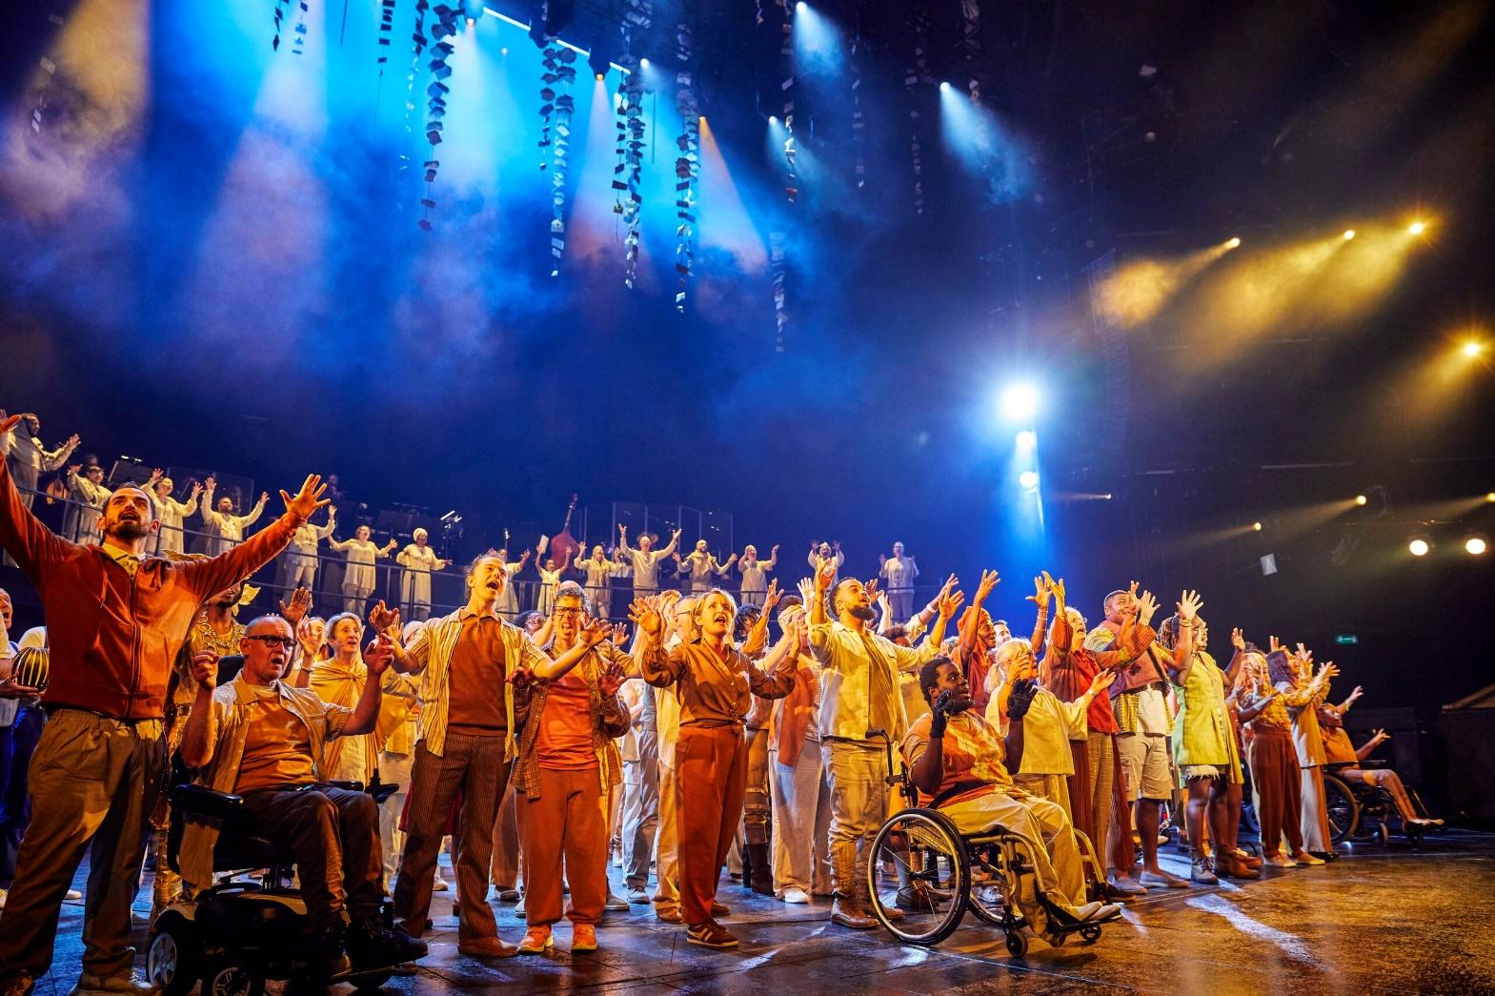
The Underworld (2023)

Slide 9
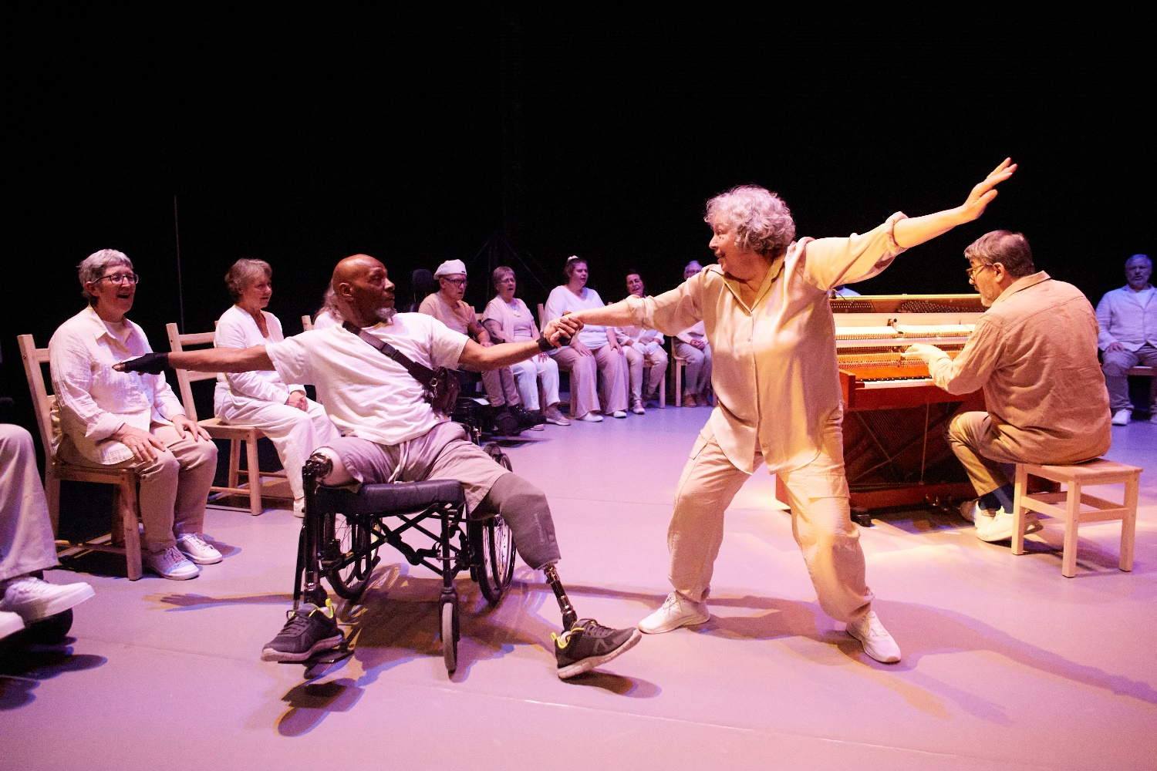
Sinfonia (2024)

Slide 11
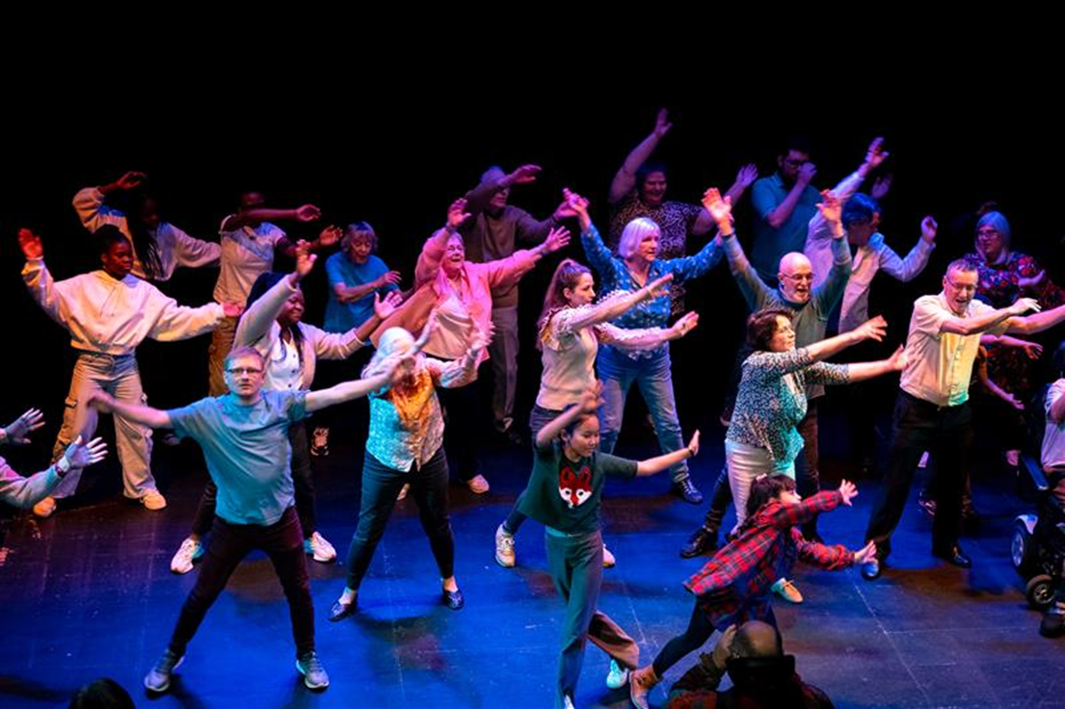
Doncaster People’s Theatre Sharing (2024)

Slide 12
The benefits of Intergenerational work
Diverse Perspectives & Storytelling – An intergenerational company brings together a wide range of lived experiences, enriching the storytelling process with multiple viewpoints and making performances more authentic and relatable.
Knowledge Sharing & Mentorship – Older members can pass down wisdom, techniques, and traditions, while younger members contribute fresh ideas and innovative approaches, fostering a dynamic exchange of skills.
Community Building & Inclusivity – Theatre with multiple generations promotes a sense of belonging, bridging generational gaps and fostering mutual respect, understanding, and empathy among participants and audiences.
Challenging Stereotypes – Working across generations challenges age-related biases, proving that creativity and talent are not limited by age
Enhanced Audience Engagement – A diverse cast attracts a broader audience, making theatre more accessible and relevant to people of all ages, which strengthens its role as a tool for social connection and cultural dialogue.

Slide 13
What next?
Doncaster People’s Theatre – New group for beginners
Citizens of the World – Music drop in
World Refugee Day – celebration
Proposal for 2026 Doncaster People’s Theatre Show
Commitment to work in some of Doncaster Most deprived Communities Cast Communities Network

