Slide 1
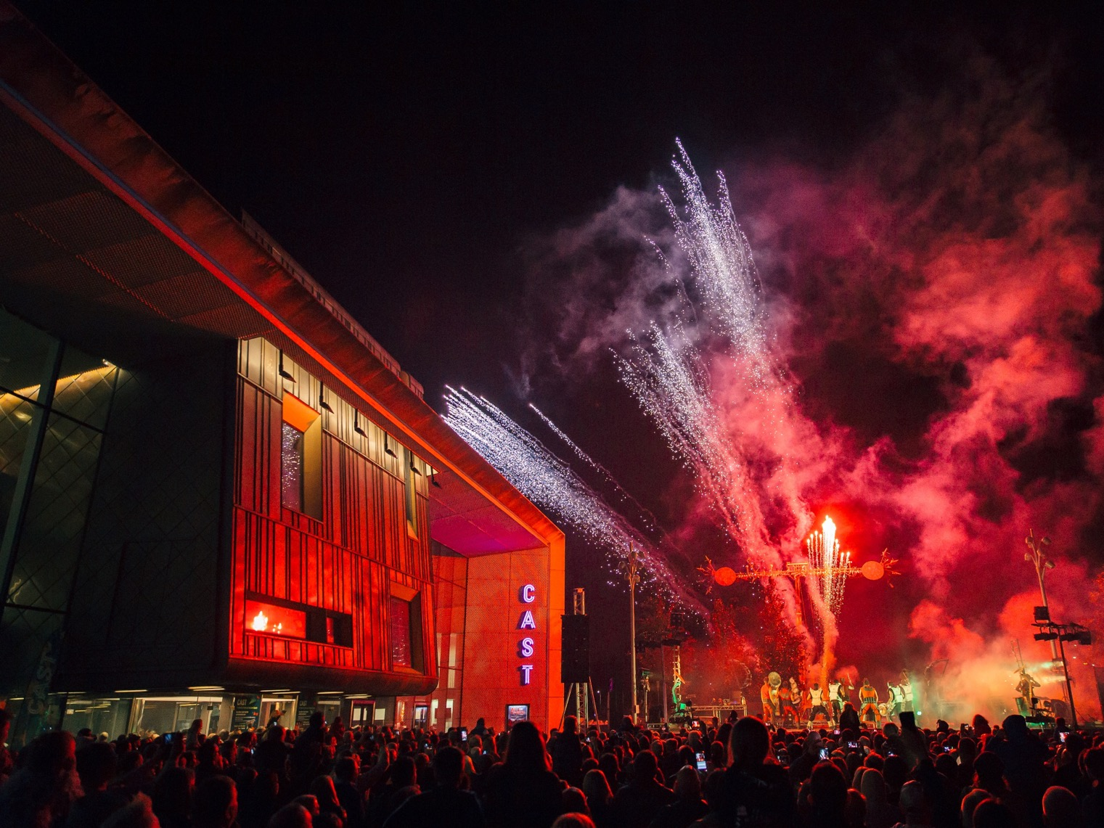
More info…………………
Corporate Partnerships
Community Ambassadors
Registered charity no 1148432
Clash of Drums 2016

Slide 2
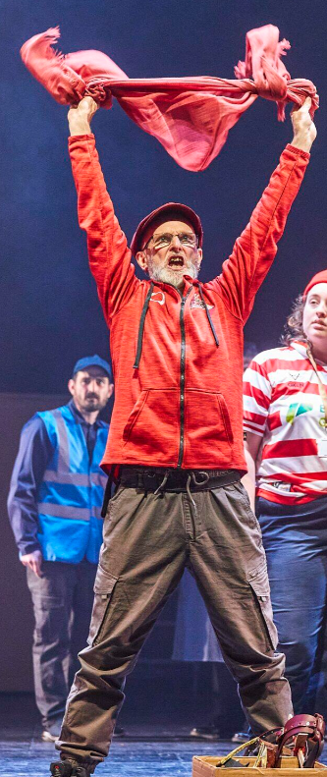
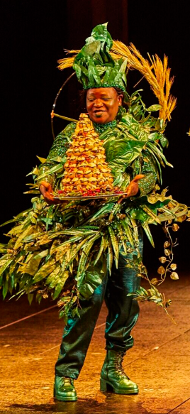
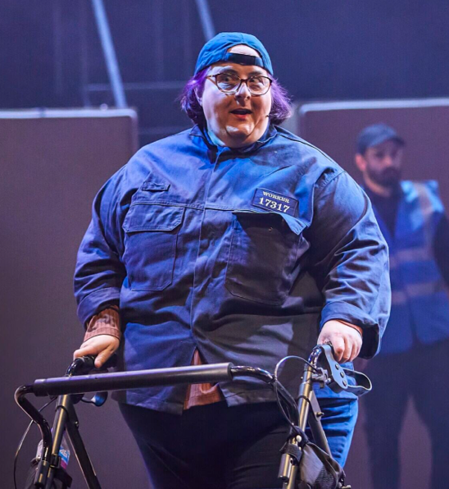
Mike
Ruth
Ondy
Notes:
The Participation department was formed in October 2016, with one full time member of staff.
We now have one full time, Head of Participation, 30-hour Community Engagement Manager, Cast Youth Theatre Manager at 20 hours per week, and a Participation Producer for 21 hours a week. In December 2022, our Participation Officer who provided administration support left the organisation, and we were not able to recruit due to the financial situation of the organisation.
Our last ACE stats reported 126 session and 3605 participants engaging in informal activities, and 439 sessions with 6140 participants informal learning activity. Totaling 565 sessions delivering 9745 participant engagements
We have major partnerships with the National Theatre and the Royal Opera House, created main stage, second space and drama space productions with Doncaster’s communities, and worked across the borough to provide bridges into the theatre, and develop relationships that respond to the need of Doncaster’s borough
Each year more than 5000 participants take part in Cast activity, independently or through schools and community organisations, and Cast works with more than 20 artists on creative projects.

Slide 3
Ambassador Programme Pilot (April – August 2024) Research Project (January – December 2025)
More info…………………
Registered charity no 1148432

Slide 4
Measuring the empowerment and confidence of culturally engaged participants to bring their communities to the theatre.
Sense of ownership from culturally engaged participants
Increased attendance of first-time theatre goers who are least likely/face significant barriers to, accessing the theatre.
Increased attendance of theatre goers who are least likely/face significant barriers to, accessing the theatre, who have either not been to Cast or have not accessed theatre in over 3 years since Covid and Cost of Living.
Confidence of each of the following groups, how this varies from those attending a production/ to a participatory event.
Likelihood to return.
Increased understanding of the organisation around the barriers to the selected groups, around accessing cultural venues and around attending dramas.
Outcomes measured
More info…………………
Registered charity no 1148432

Slide 5
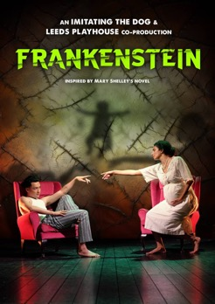
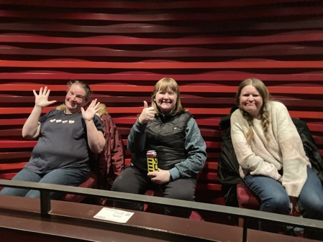
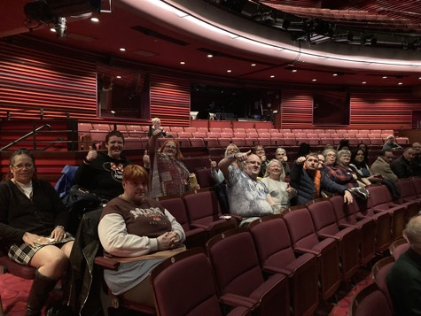
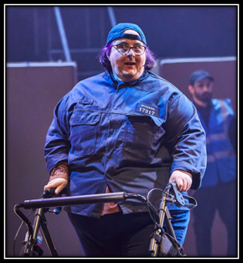
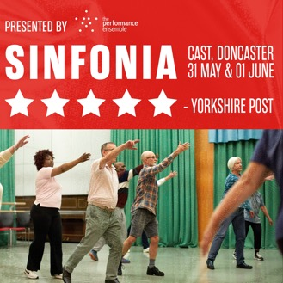
25 People
20 People
More info…………………
25 People

Slide 6
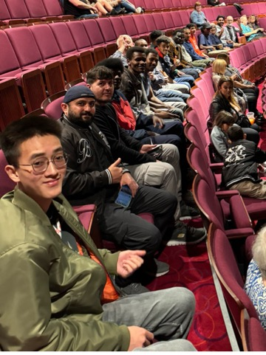
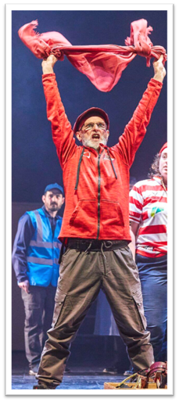
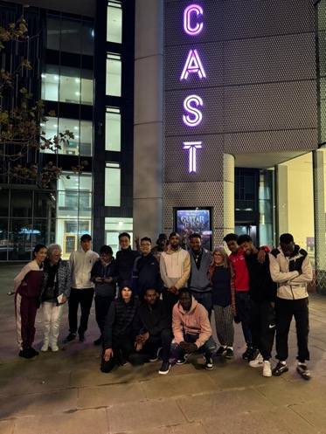
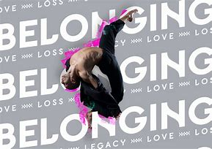
20 People
20 people
22 People
25 people
10 People

Slide 7
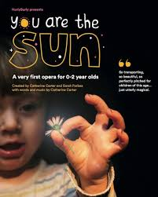
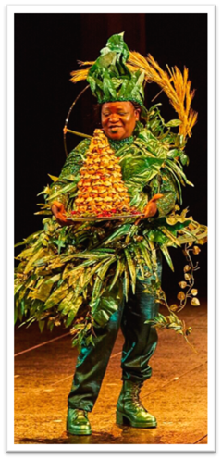
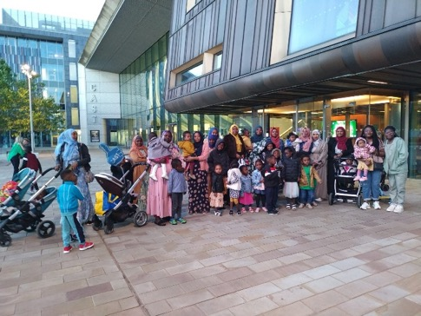
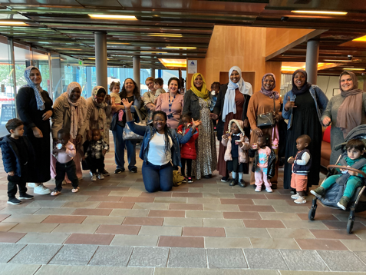
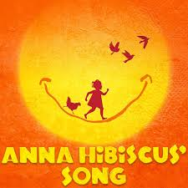
25 people
More info…………………
70 people
18 people
25 people
30 people
24 people

Slide 8
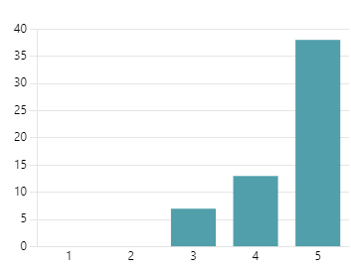
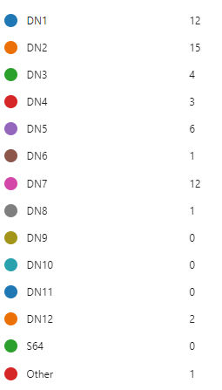
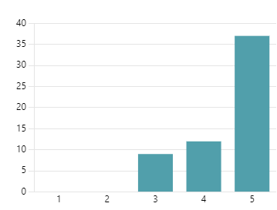
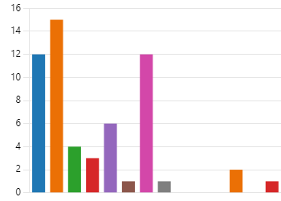
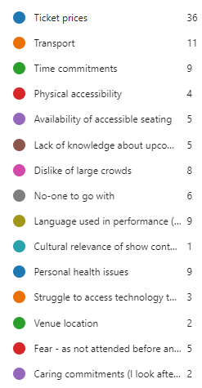
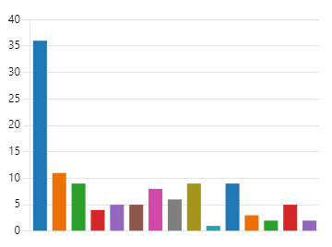
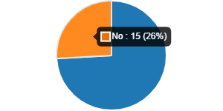
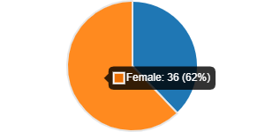
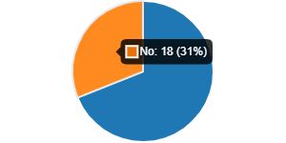
Pre-Show Questionnaire
58 Respondents

Slide 9
Feedback
More info…………………
Everyone who came to see the performance told me how much they enjoyed it. Including one of our members said that she was 60 years old and never seen a live performance.
“I am crying happy tears because I am so happy…this has been one of the best days of my life”
The seats are uncomfortable
The visit was wonderful looked after very extremely well. The acting was Oscar worthy in my opinion. My only negative for me personally was the brightness of the lighting however, this was perfect for the story. I was captivated. Thank you
Very welcomed and valued . Made me question and reflect on the whole question of life and death, new life, the world, responsibility to others and the world, love and friendships

Slide 10
Next Phase: Ambassador
More info…………………
Embedded Researcher Emilie
Pre & Post show questionnaires (multiple languages)
4 shows over the year
Visits within community settings
Ambassadors representing Cast at events
Return offer
Tracking first time attenders
Next

Slide 11
More info…………………
Corporate Partnerships
Thanks for listening
Registered charity no 1148432
Clash of Drums 2016

